Slide 1



INF0 445: Adv. Database Management Lecture 10
Instructor: Greg Hay
February 20, 2018

Slide 2
Agenda
Announcements
Maintenance
Monitoring
SQL
Sub-Query challenge ?

Slide 3



Slide 4
Announcements
Week 8
~2 weeks remaining of ‘new’ material scheduled
Database Administration
Monitoring
Maintenance
Optimization

Slide 5
Announcements
If you want ‘full-stack’ on your resume…
Establish a web front-end to your database
Be able to enter/modify data via stored procedure

Slide 6
Announcements
Project status
Continue writing code to populate transaction tables
Web-based/actual production code
Client-based/test transaction code
Critical for troubleshooting and monitoring labs
Will need to create thousands of DML (INSERTs, UPDATEs and DELETEs) per minute with code by week 10

Slide 7

Questions?

Slide 8

RAID
Redundant
Array
Independent
Disks

Slide 9
Hardware Considerations
Configuring Database Files with RAID Systems
Not part of SQL Server
Part of the hardware configuration
Types
RAID 0
RAID 1
RAID 5
RAID 0 + 1 (‘ten’)

Slide 10
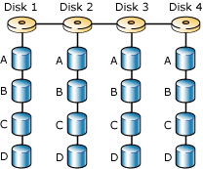
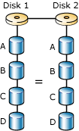
Hardware Considerations
RAID Systems
RAID 0
Disk Striping
Great performance
Lousy fault tolerance
Great disk cost-efficiency
RAID 1
Disk Mirroring
Good performance
Better fault tolerance
Fair disk cost-efficiency (N/2)

Slide 11
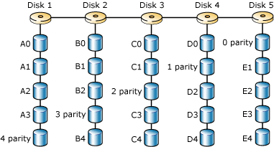
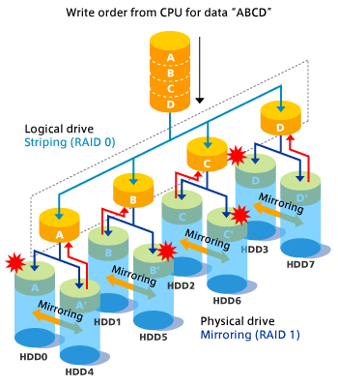
Hardware Considerations
RAID Systems
RAID 5
Striping + parity
Fair performance
Fair fault tolerance
Good disk cost-efficiency
N-1
RAID 1 + 0
Mirroring + striping
Great performance
Great fault-tolerance
Fair disk cost-efficiency

Slide 12

Hardware Considerations
Read about RAID systems!
Important to know differences
http://msdn.microsoft.com/en-us/library/aa217083.aspx

Slide 13


Slide 14



Database Maintenance
Routine work to keep system running

Slide 15
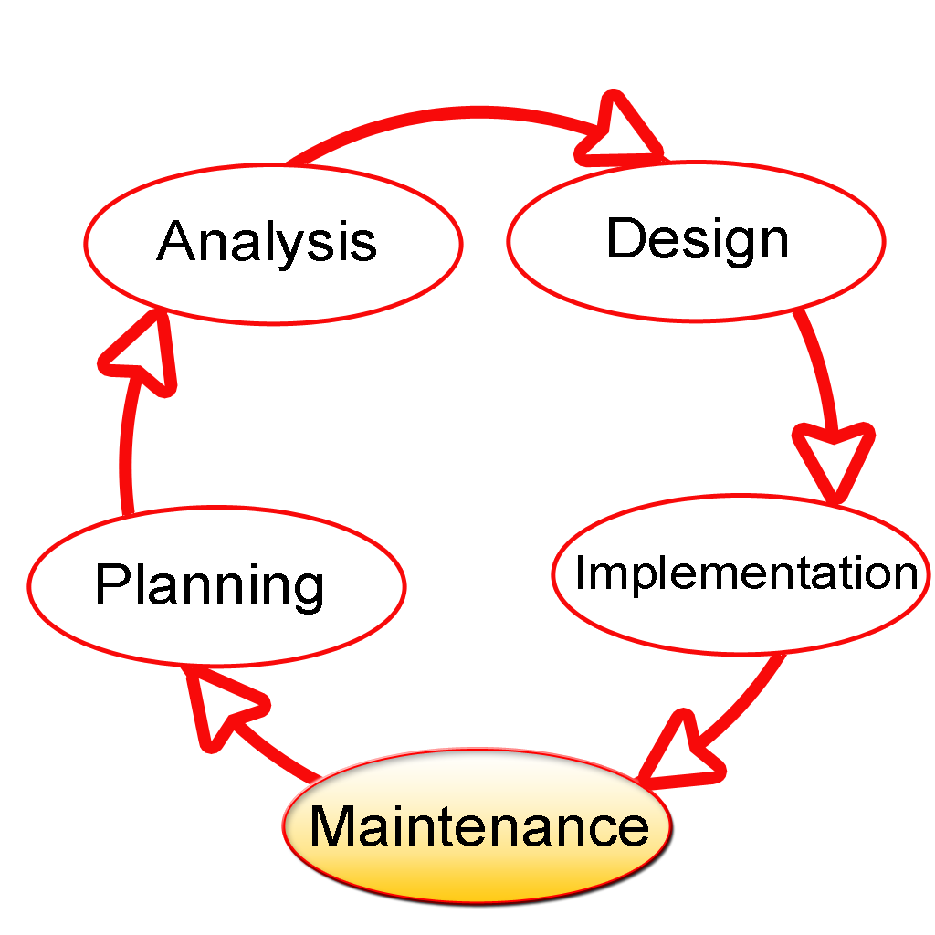

Slide 16
Know Database Environment
Transactions
Data flow
Customers (internal and external)
Hardware
Database objects
Skills of DBA staff

Slide 17
Know Database Environment
Transactions
How does data come into the system?
How often does data come in?
Which objects are affected?

Slide 18
Know Database Environment
Dataflow
How data modified AFTER in the system
SQL Agent jobs
Triggers
O/S system tasks
Where is data leveraged throughout the system?
When do modifications or movement occur?
Who depends on these updates?

Slide 19
Know Database Environment
Customers
Define WHO they are
specific group, people and office location
Define each group’s data needs
reading/writing requirements
Listen to them!
Define most-urgent data/processes

Slide 20
Know Database Environment
Hardware
What hardware supports databases?
Where are single-points of failure?
How powerful are these systems?
What are specific capabilities or capacity?
What is the useful life of each component?
Who is the vendor that sold the equipment?
What is the emergency contact for support?

Slide 21
Know Database Environment
Database objects
All objects across entire environment
Which are most important to customers?
Which objects have the most activity?
Dependencies between objects?

Slide 22
Know Database Environment
Database objects
Logins
Stored procedures
Attributes
Data types
Constraints
Functions
Triggers

Slide 23
Know Database Environment
Skills of DBA staff
Which DBA is best-suited for each task?
What opportunities to strengthen team?
Career aspirations of each technician?
SWOT analysis: where are vulnerabilities?

Slide 24


Slide 25
Defining System Vulnerabilities
What needs to be done to keep running?
Define the events that will impact the database environment in the absence of simple maintenance
Hard drive fills up
Job dependencies

Slide 26
Defining System Vulnerabilities
The better DBA staff can understand the database environment, the better we are able to define the risks and threats to our database systems…and take action.

Slide 27
Routine Maintenance
Once we define the threats to an environment we can define DAILY TASKS that alleviate or mitigate the risks that will adversely affect system functionality.
Examples:
Daily backups of critical databases
Checking error logs
Charting performance trends baselines

Slide 28
Routine Maintenance
Maintenance Tasks
reduce vulnerabilities throughout the environment
some may occur every 15 minutes
such as backups of the transaction log
some once each day
stand-up meeting of entire DBA team
writing shift hand-off report

Slide 29
Routine Maintenance
Goals
build a routine set of tasks that improve the value of the database environment
cover all components
Hardware
Processes
People

Slide 30
Routine Maintenance
Must address defined vulnerabilities with tasks that proactively reduce the opportunity for failures to occur

Slide 31
Routine Maintenance
Key Characteristics
All maintenance is defined, scheduled and practiced
Build a routine that is measureable (effectiveness)
Assessed for improvements and flaws
Optimized over time

Slide 32
Routine Maintenance
General topics
Security
Disaster Recovery
System Performance
Staff skills

Slide 33
Routine Maintenance
General topics
Customer Relations (internal mostly)
Optimization/Tuning
Scalability
Reporting
Data movement
High-availability

Slide 34
Routine Maintenance
Bottom Line
We must define the threats to our database system and take action proactively to reduce threats

Slide 35


High-Level Question
What is a Maintenance Plan?

Slide 36

High-Level Question
When is a good place for Maintenance Plan?

Slide 37

Working with SQL Agent
Creating a Maintenance Plan
Automated Wizard with common tasks
Backup databases
Shrink files
Rebuild Indexes

Slide 38
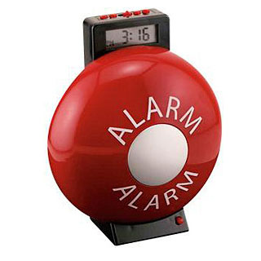
High-Level Question
What is an Alert within SQL Server?

Slide 39

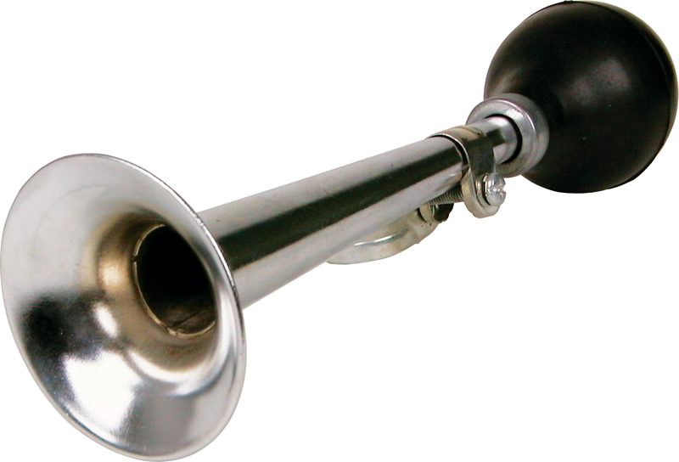
High-Level Question
How is an Alert ever going to help me?

Slide 40

Working with SQL Agent Alerts
Configuring Alerts
SQL Server Agent looks for issues
Find issues prior to becoming problems
SQL Server Agent can respond to issues
Run other jobs
Send email
Take backups

Slide 41
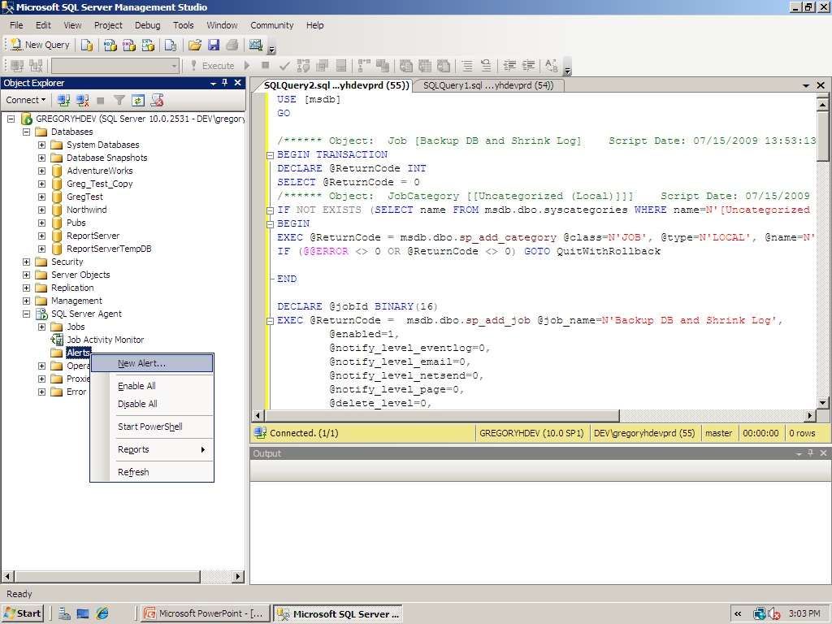

Slide 42
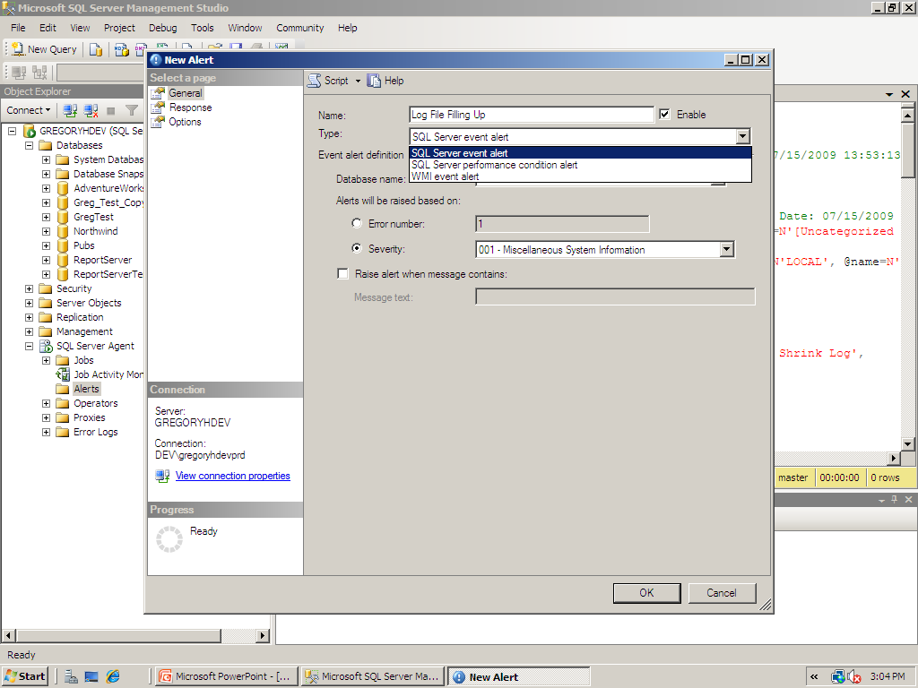

Slide 43
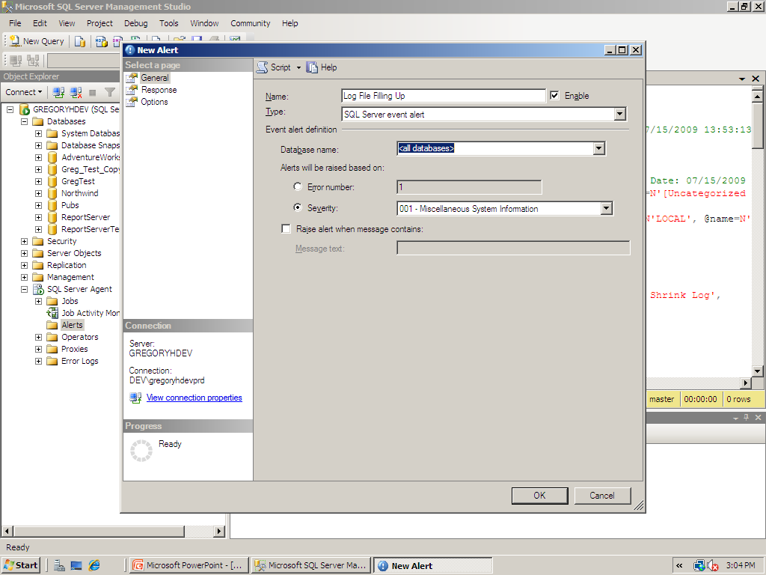

Slide 44
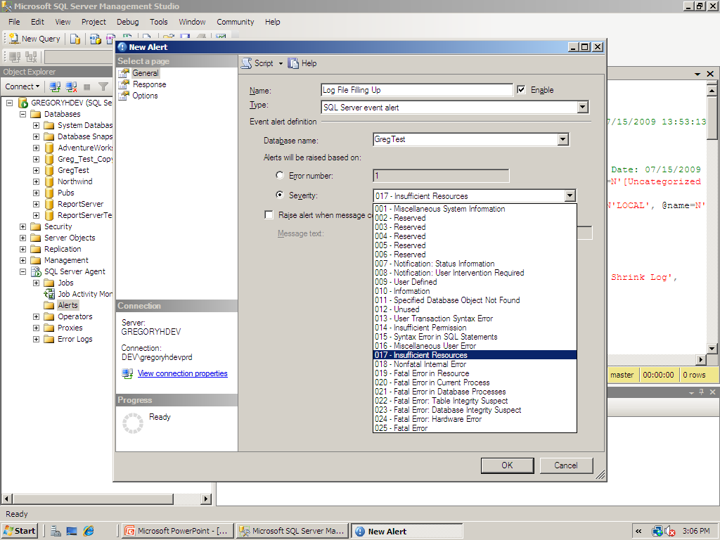

Slide 45
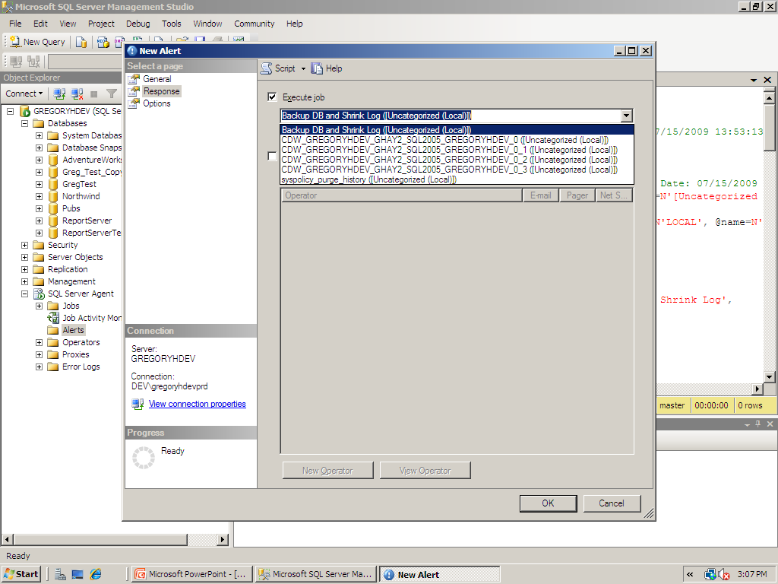

Slide 46
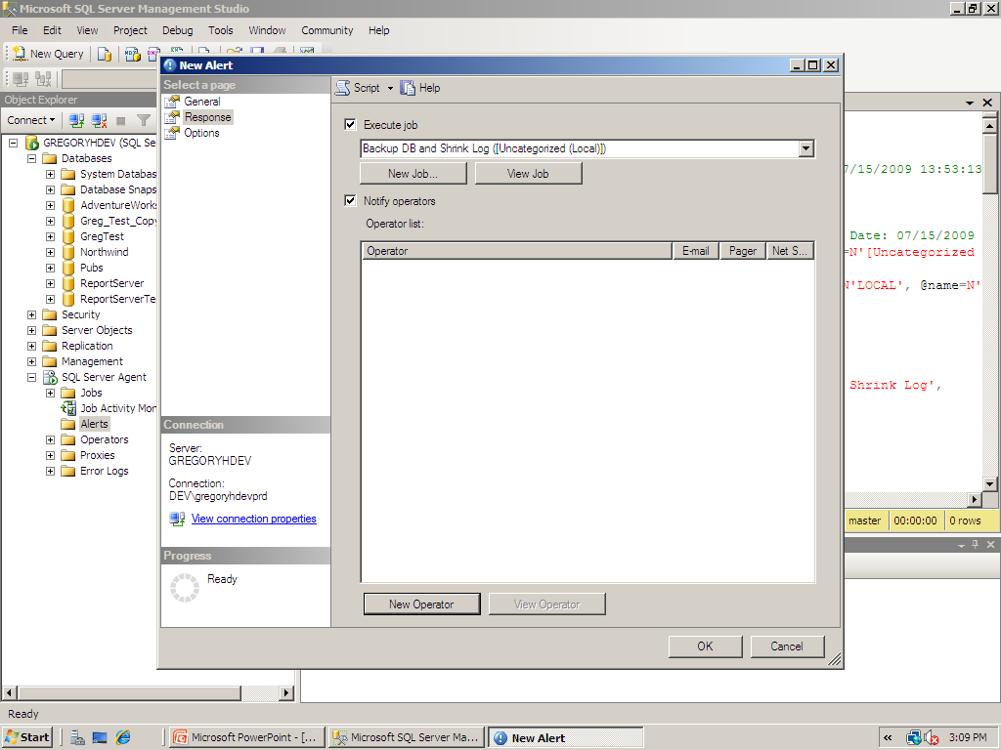

Slide 47
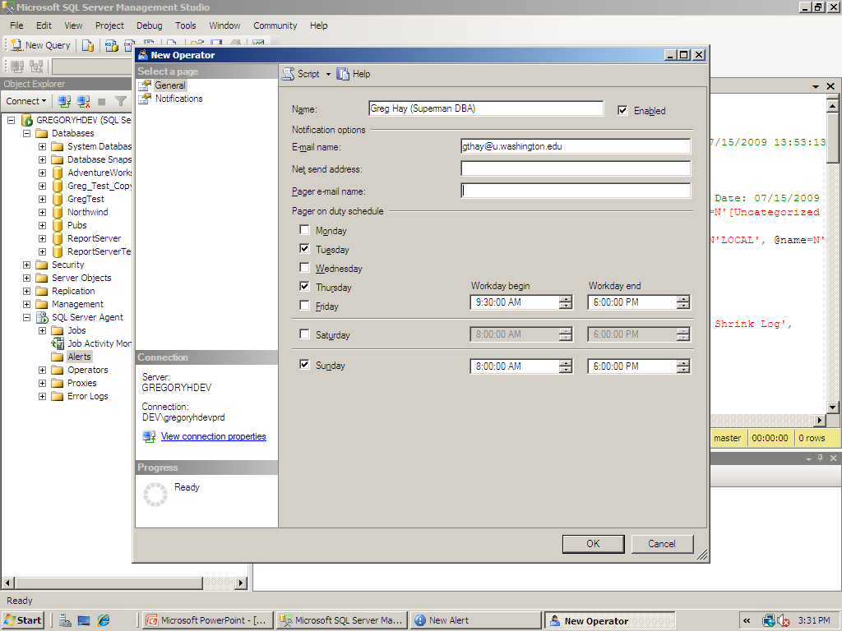

Slide 48
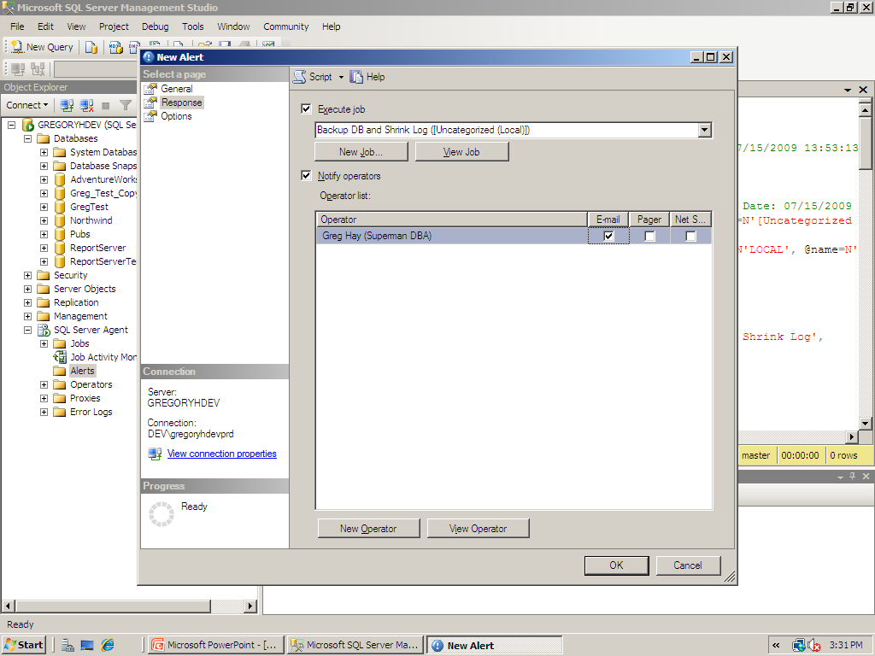

Slide 49
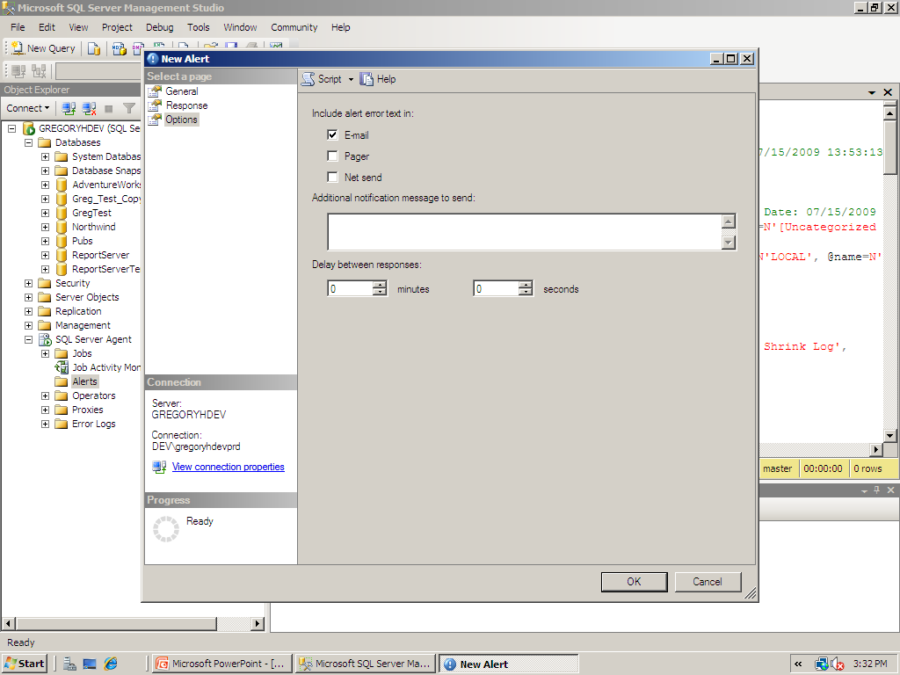

Slide 50
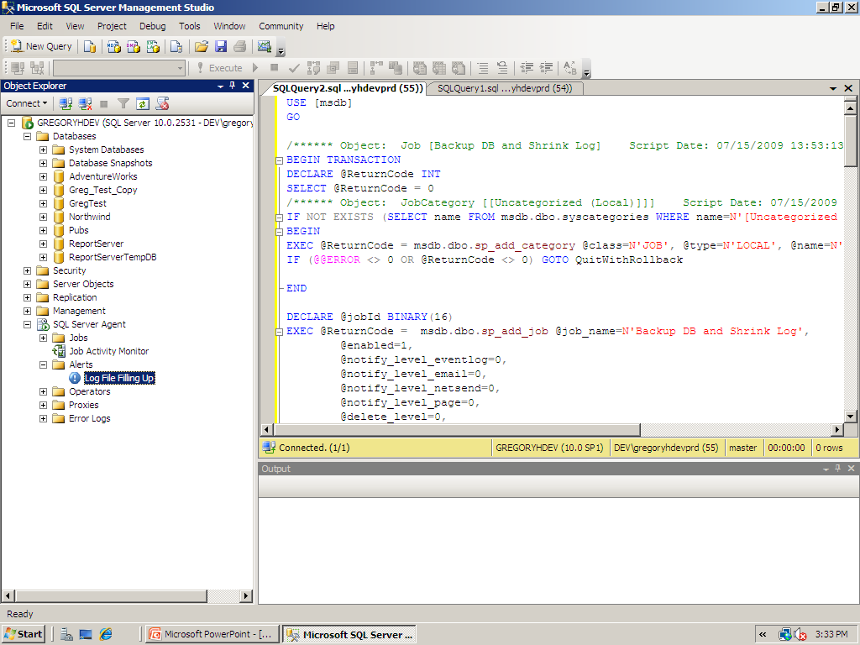

Slide 51
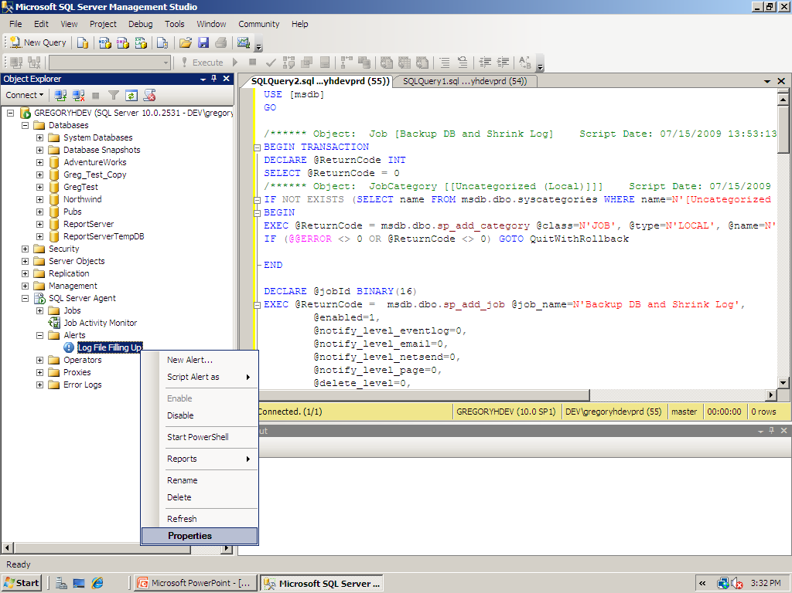

Slide 52
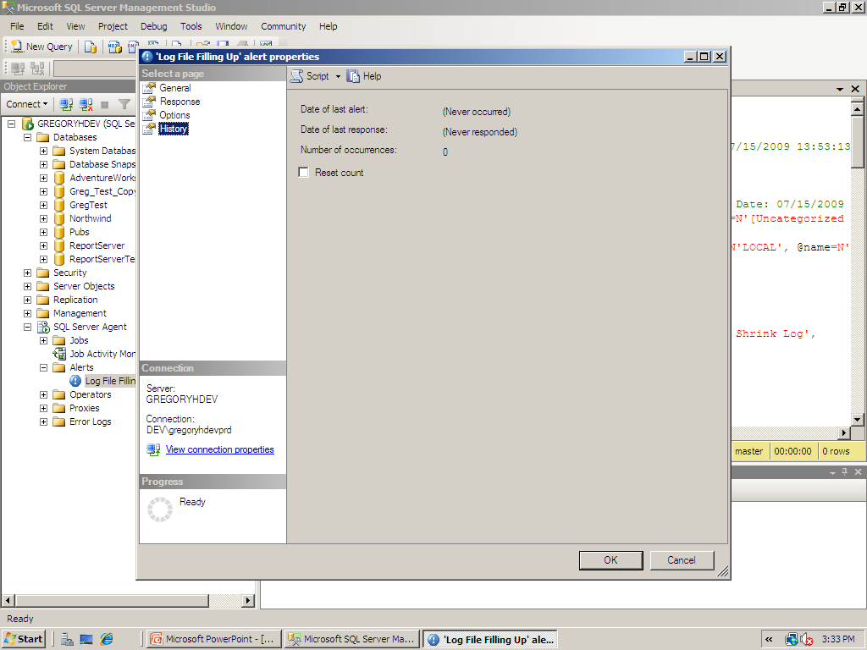

Slide 53
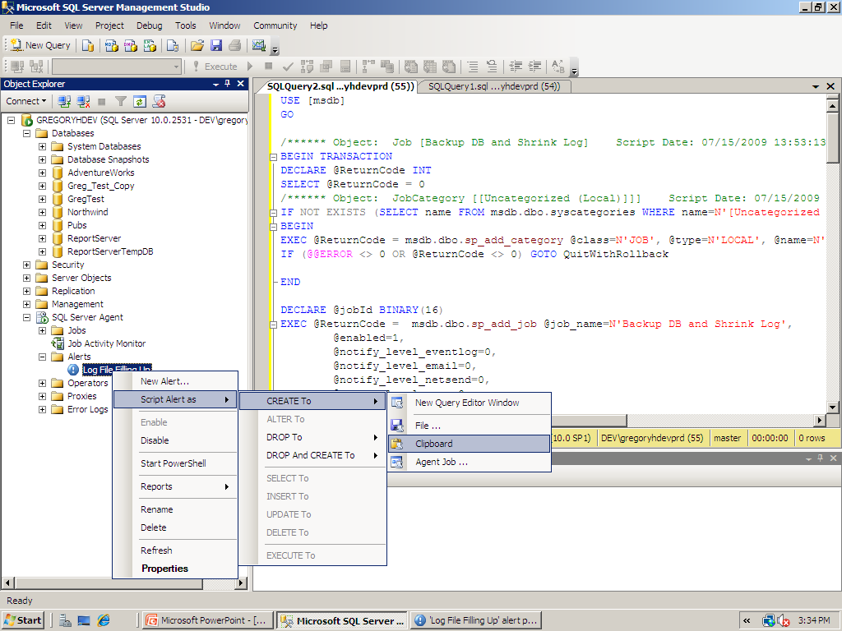

Slide 54
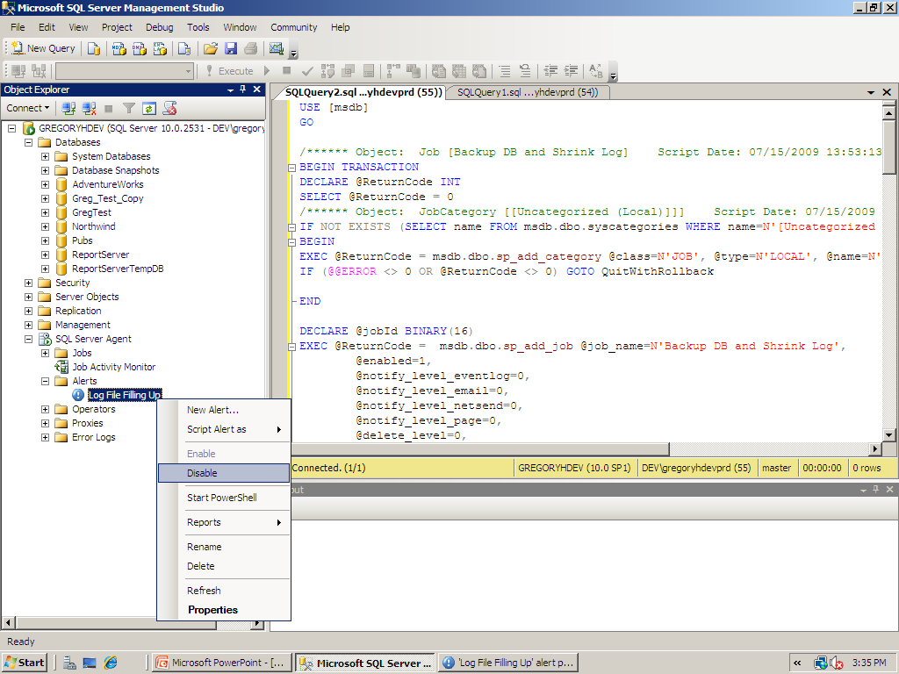

Slide 55
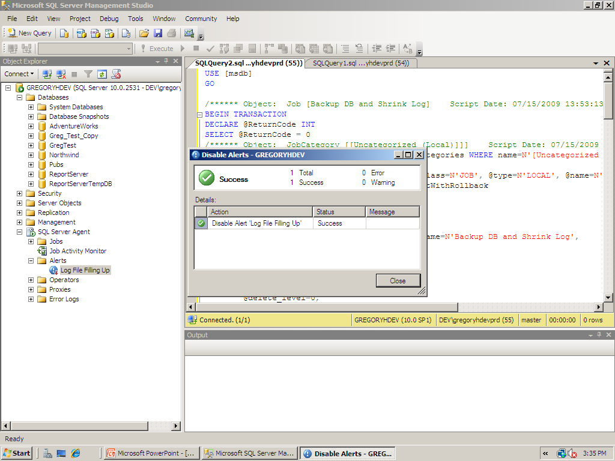

Slide 56

SQL Server Agent

Slide 57

SQL Server Agent: Best Practices
Know your environment!!
Know details of databases behavior
Types of transactions
Volume of transactions
How\where data is stored on disk
Memory\CPU peaks

Slide 58
SQL Server Agent: Best Practices
Leverage SQL Agent
Repetitive proactive tasks
Rebuilding indexes or Update statistics

Slide 59
Questions?

Slide 60


Break: 10-minutes

Slide 61

Monitoring Databases
SQL Server Profiler
System monitor (“PerfMon”)
Activity Monitor
Task Manager
Brief intro into DMVs

Slide 62
Know Database Environment
Transactions
Data flow
Customers (internal and external)
Hardware
Database objects
Skills of DBA staff

Slide 63
Monitoring SQL Server
Plethora of Tools
SQL Server Profiler
System Monitor (‘PerfMon’)
Dynamic Management Views and Functions

Slide 64
High-Level Question
Why should I monitor SQL Server performance?

Slide 65
High-Level Answer
Why should SQL performance be monitored?
Monitoring SQL Server allows a DBA to proactively
address concerns before they escalate into customer
impacting issues

Slide 66
High-Level Question
What scenarios should SQL Server performance be monitored?

Slide 67
High-Level Answer
What scenarios should SQL Server performance be monitored?
when there is a performance issue within SQL Server
when there is NOT (benchmarking)

Slide 68
High-Level Question
How can I monitor SQL Server performance?

Slide 69
High-Level Answer
How can I monitor SQL Server performance?
SQL Server performance can be monitored with several
tools available with SQL Server as well as other 3rd-
party applications:
SQL Profiler
System Monitor
DMVs
DMFs

Slide 70
High-Level Question
What is SQL Profiler?

Slide 71
High-Level Answer
What is SQL Profiler?
SQL Profiler is a popular monitoring tool available with
SQL Server that allows viewing and capturing all
transactional activity in SQL Server

Slide 72
Working with SQL Server Profiler
Trace
Subsystem of SQL Profiler
Leverages external API
Flexibility in calling subsystem in addition to applying filters to data capture

Slide 73
Working with SQL Server Profiler
Defining a Trace
Have a plan!!
Data scope
Filters
Events and Data Columns
Start with a predefined template
Different scenarios have distinct template
Build a set of templates to capture info quickly

Slide 74
Working with SQL Server Profiler
Executing a Trace
Client-side
Incurs substantial resource overhead
Avoid if at all possible
Server-side
Less impactful to the server being monitored
Usually initiated via command line or script

Slide 75
Working with SQL Server Profiler
Saving a Trace
File
Greater flexibility in managing data output
Built-in function fn_trace_gettable allows converting multiple files in to single table
Table
Incurs substantial resource overhead
Avoid if possible

Slide 76
Working with SQL Server Profiler
Defining a Trace
Narrow data collection to fit purpose
Avoid collecting too much data
Apply filters

Slide 77
Working with SQL Server Profiler
Starting, Pausing and Stopping a Trace
Starting a Trace
Data begins to be collected
Pausing a Trace
Data collection is simply suspended
Easier to read data on screen
Stopping a Trace
Trace session is terminated

Slide 78
Working with SQL Server Profiler
Saving a Trace Log
Trace Definition
Create via GUI then save
Allows for a job to be created to run in SQL Agent
Trace Data
Able to save as XML as well

Slide 79
Working with SQL Server Profiler
Creating a Replay Trace
Synchronize with Database Backup
Exact transactions are captured to be replayed in sequence from a point in time
Synching backup allows most-accurate comparison
Can be code only or simulated replay (with delays)
SQL Server authentication due to inability to imitate a Windows user

Slide 80
Questions?

Slide 81

Demo: SQL Server Profiler

Slide 82
High-Level Question
What is System Monitor?

Slide 83
High-Level Answer
What is System Monitor?
System Monitor (a.k.a. ‘PerfMon’) is a Windows
O/S tool; it measures the consumption of
system resources with 100 of events
and counters

Slide 84
High-Level Question
When would I want to use System Monitor?

Slide 85
High-Level Answer
When would I want to use System Monitor?
System Monitor is the best tool to capture baseline
activity to measure ‘normal’ system behavior.
Also, when contention of resources
becomes an issue, System Monitor can
capture current consumption levels.

Slide 86
System Monitor
Correlate Transactional Activity
Tie resource consumption to events or code
Together with Profiler can provide full context of server state in response to specific queries

Slide 87
System Monitor
Capture data to a Counter Log
Required to fully analyze data
Only slight overhead when capturing more counters

Slide 88

Questions?

Slide 89
Demo: System Monitor

Slide 90
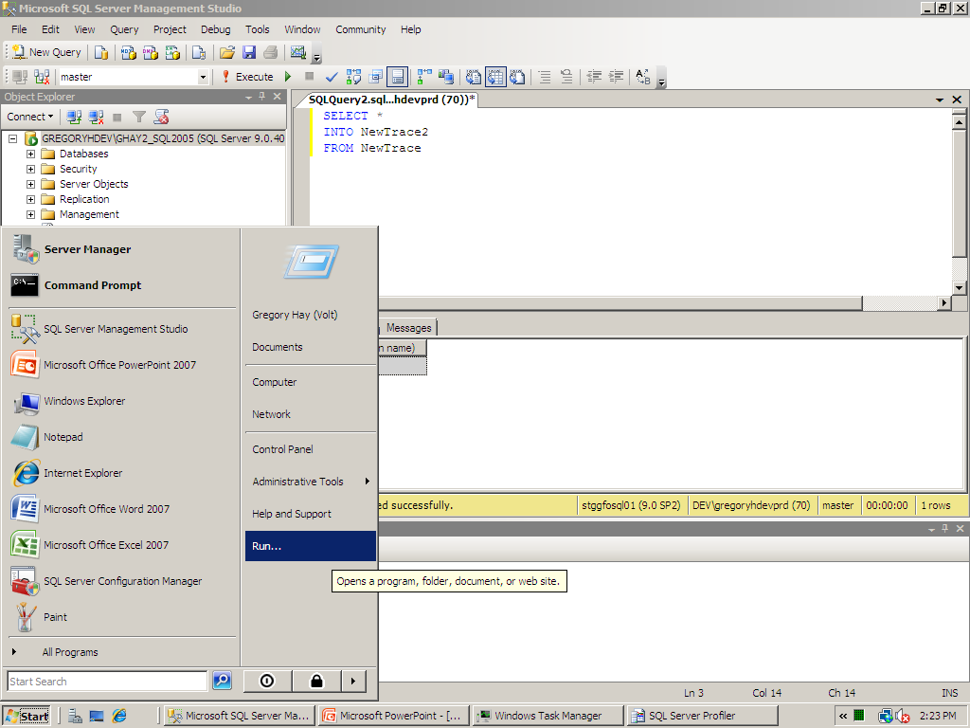

Slide 91
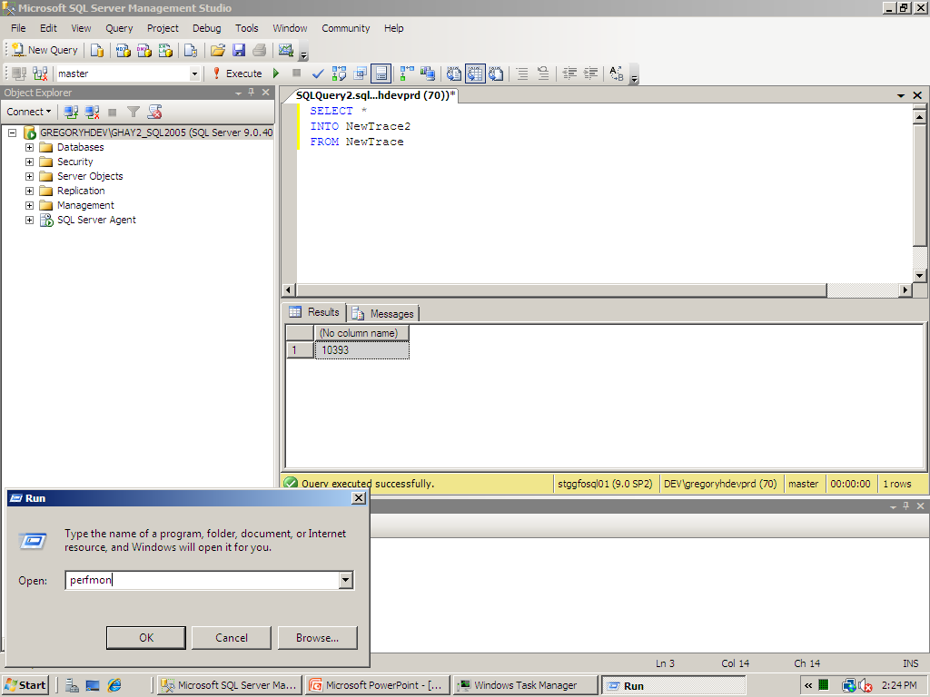

Slide 92
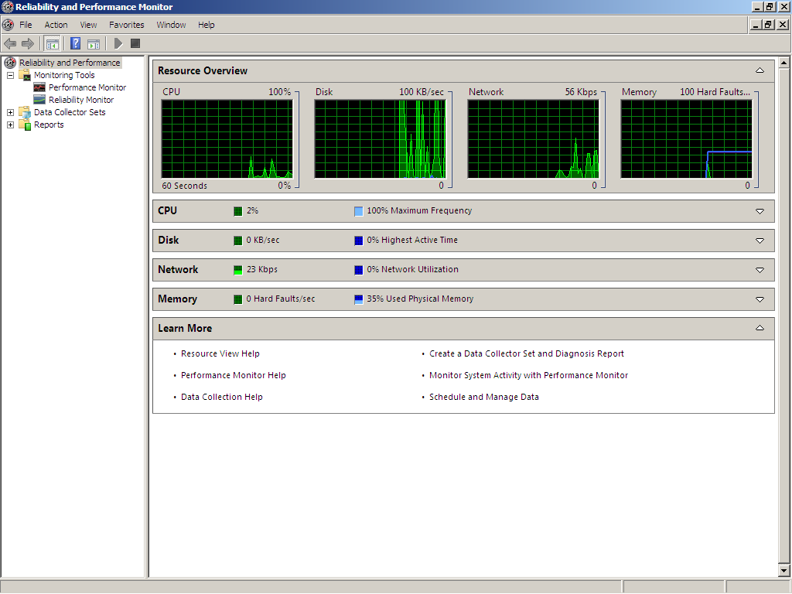

Slide 93
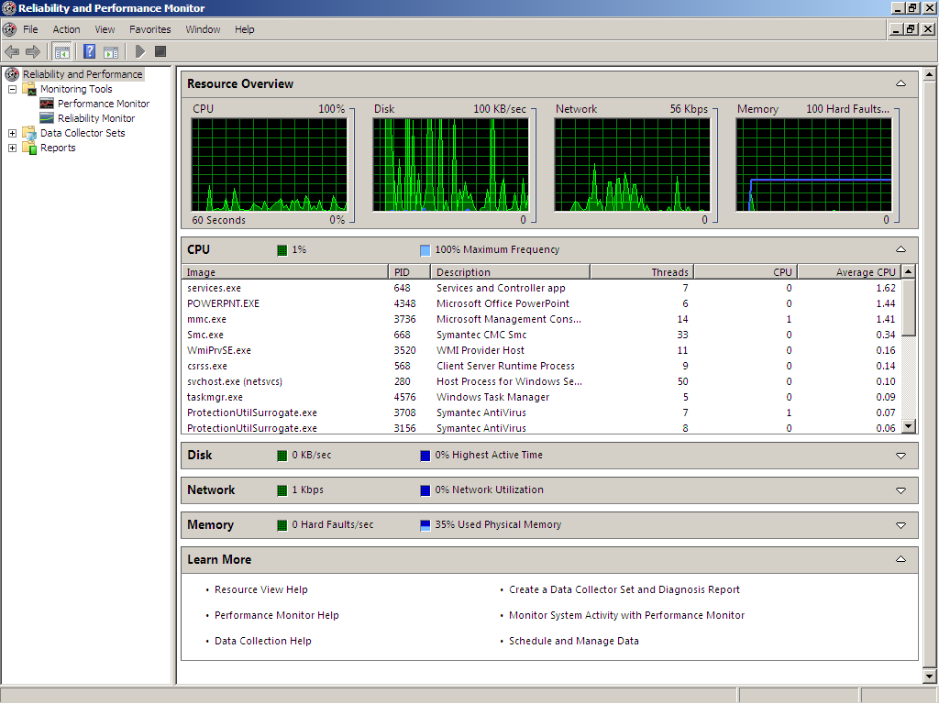

Slide 94
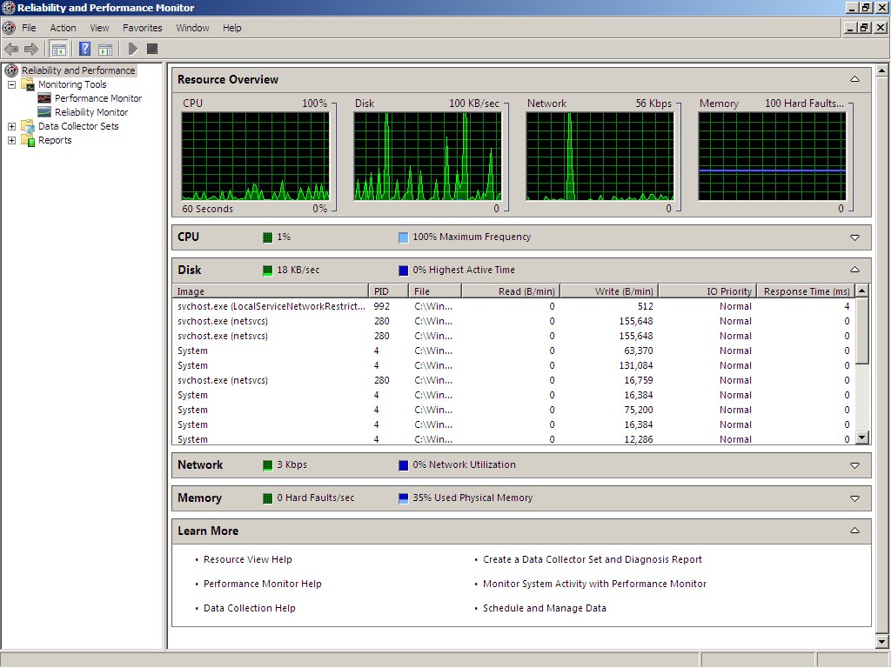

Slide 95
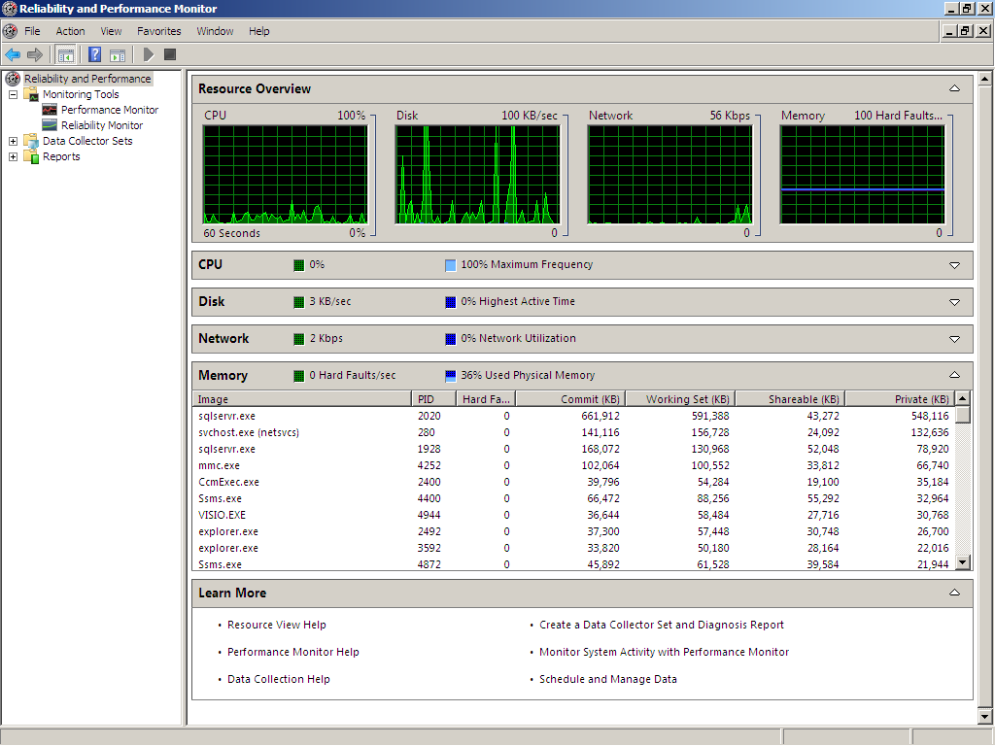

Slide 96
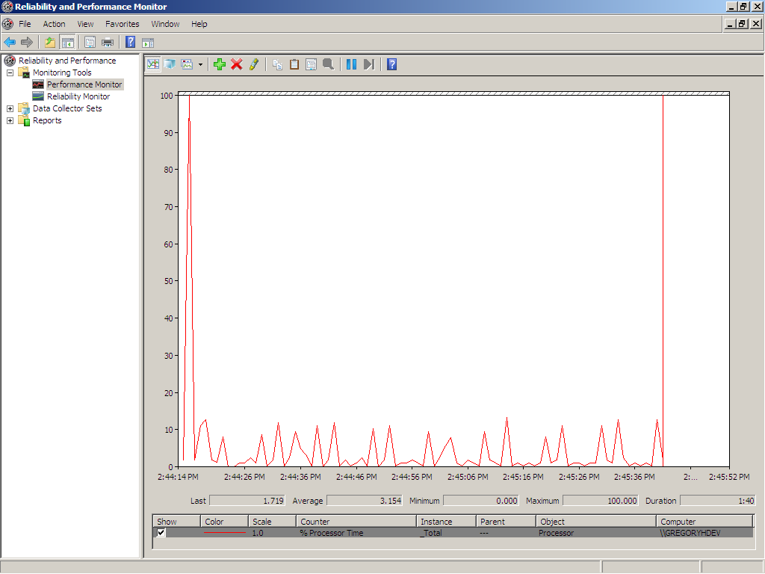

Slide 97
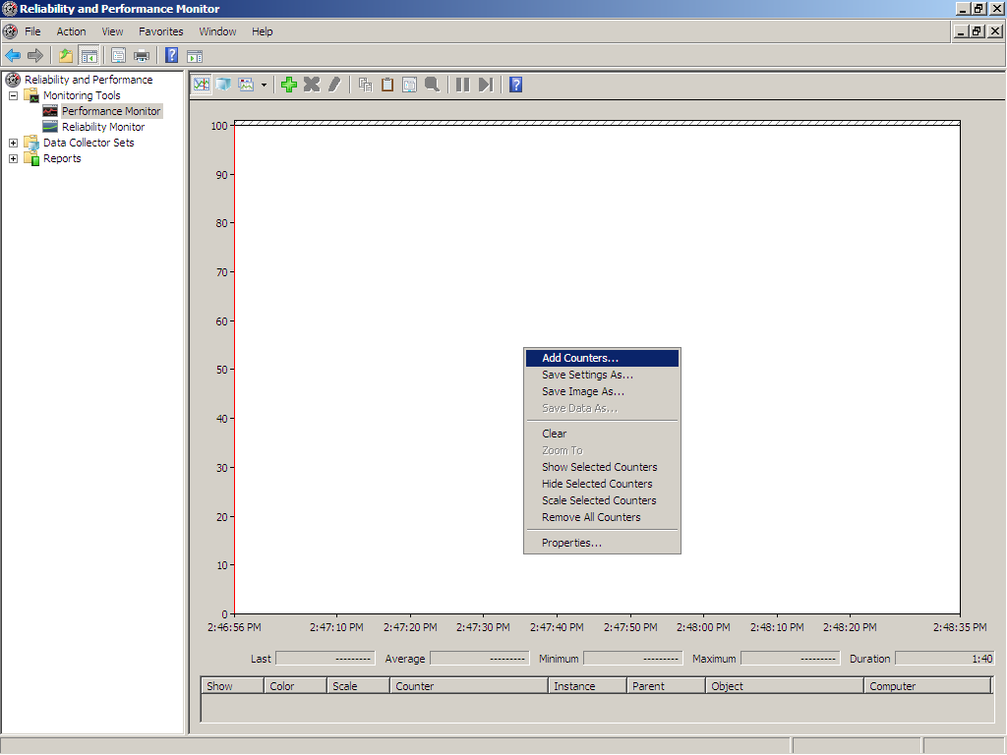

Slide 98
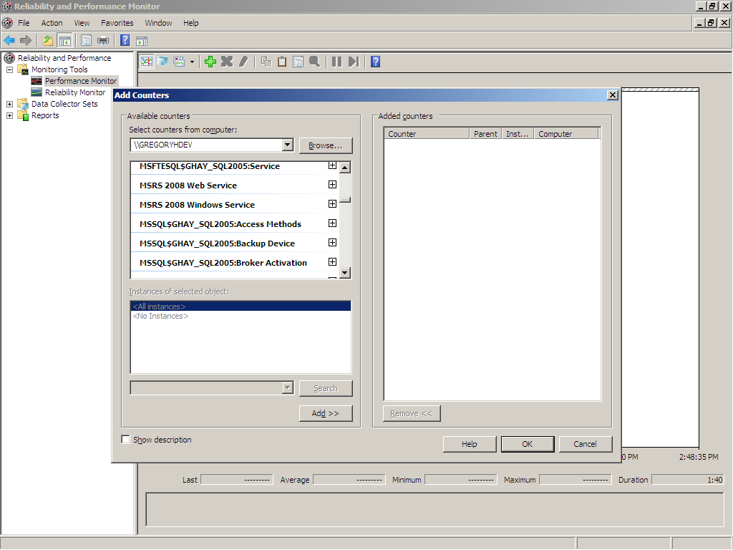

Slide 99
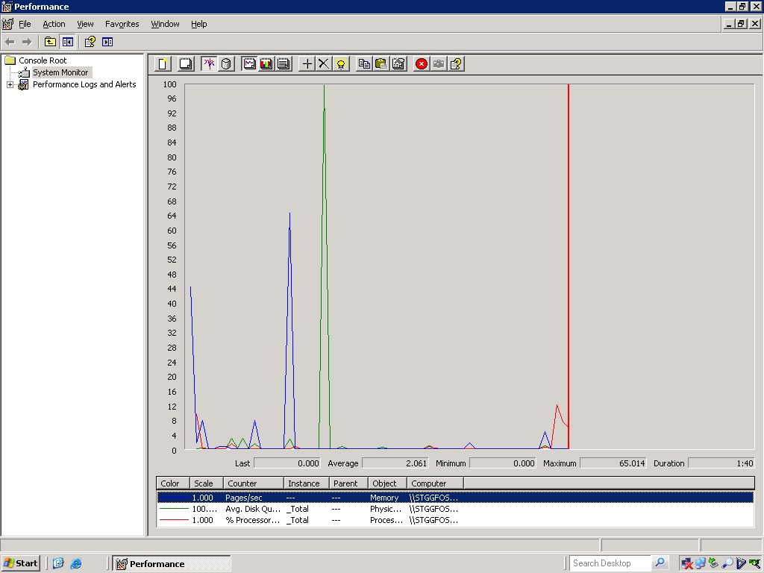

Slide 100
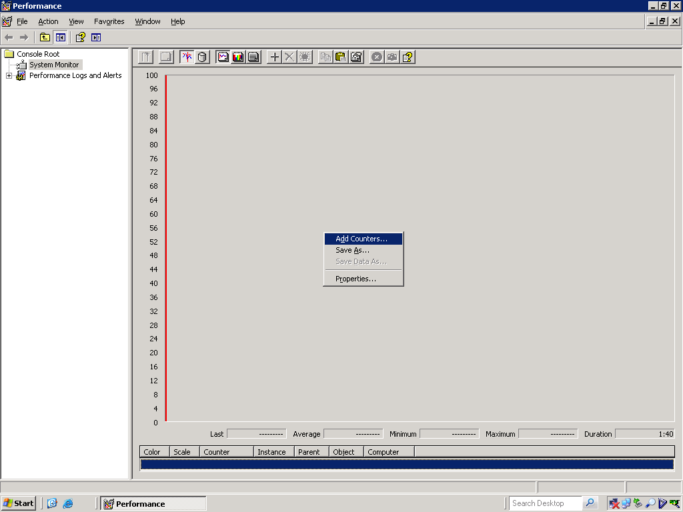

Slide 101
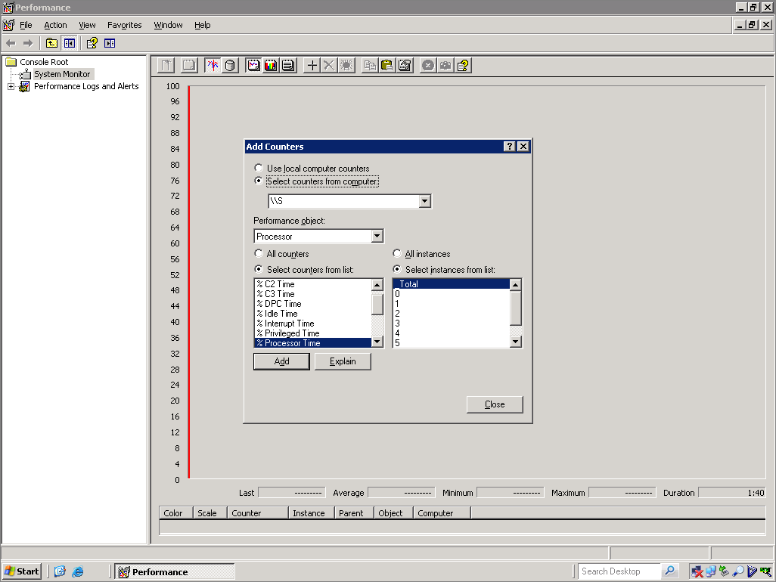

Slide 102
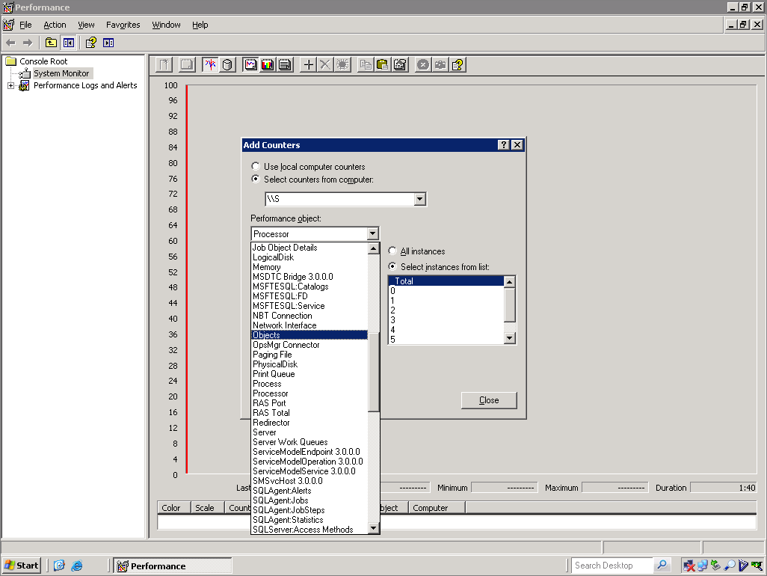

Slide 103
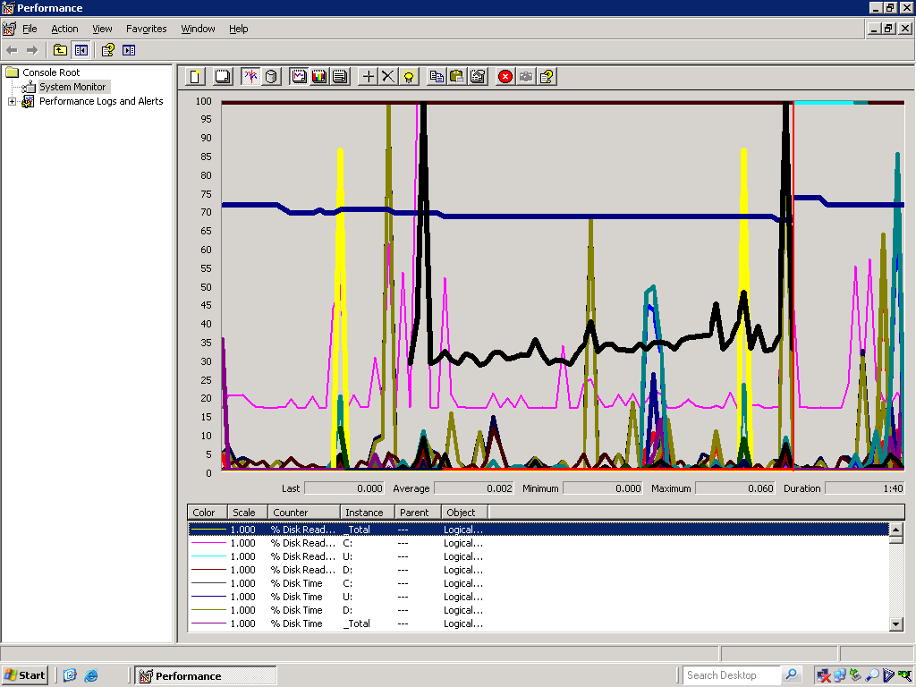

Slide 104
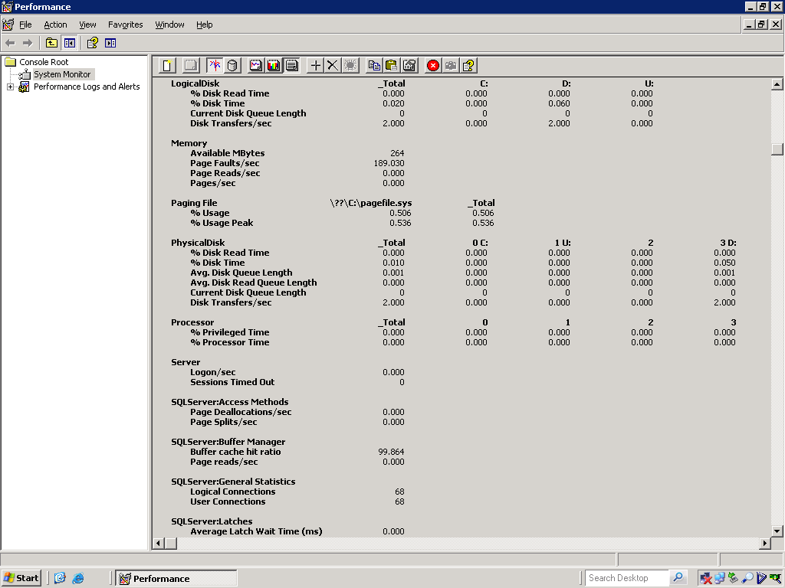

Slide 105
Questions?

Slide 106
System Monitor
Counter Logs
Runs in the background to identify trends
Resource consumption

Slide 107
Demo: Counter Logs in Perfmon

Slide 108
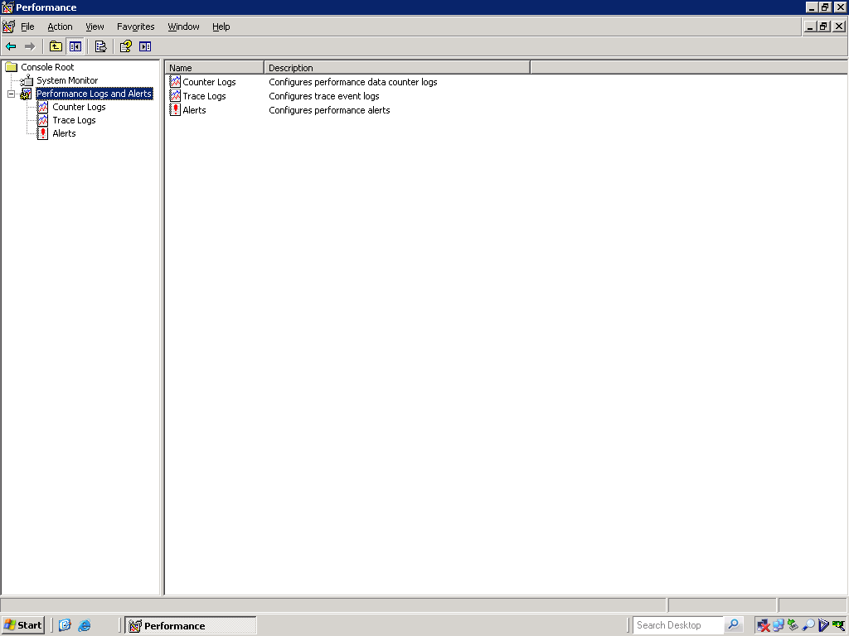

Slide 109
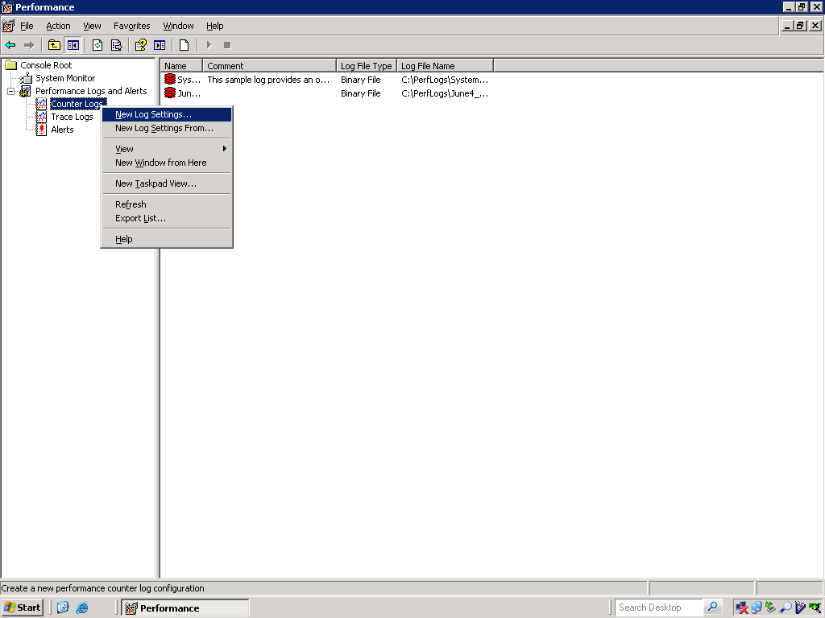

Slide 110
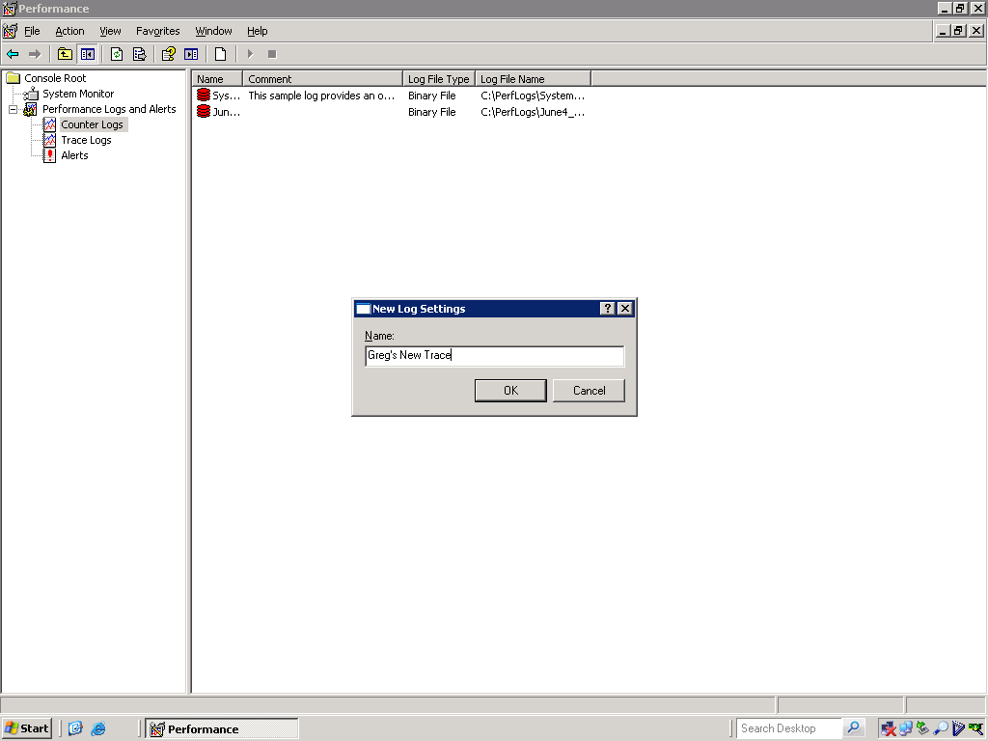

Slide 111
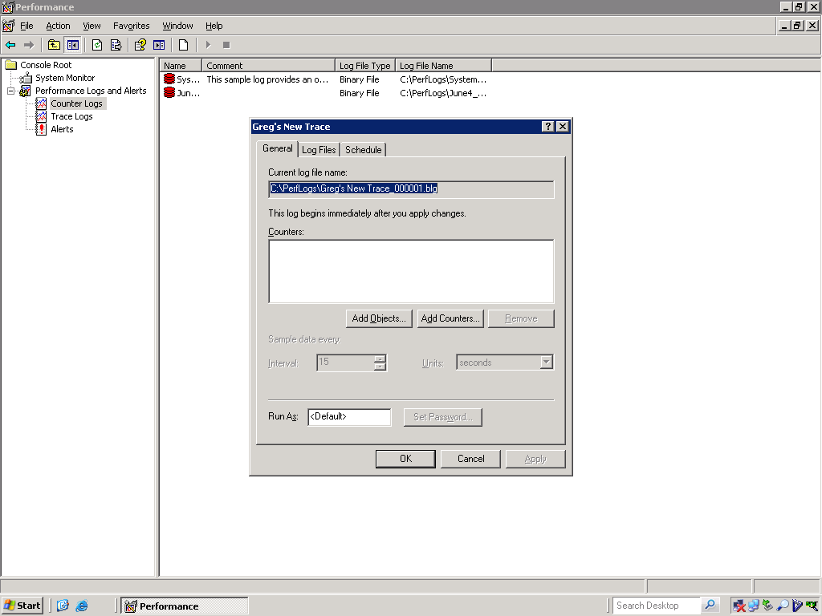

Slide 112
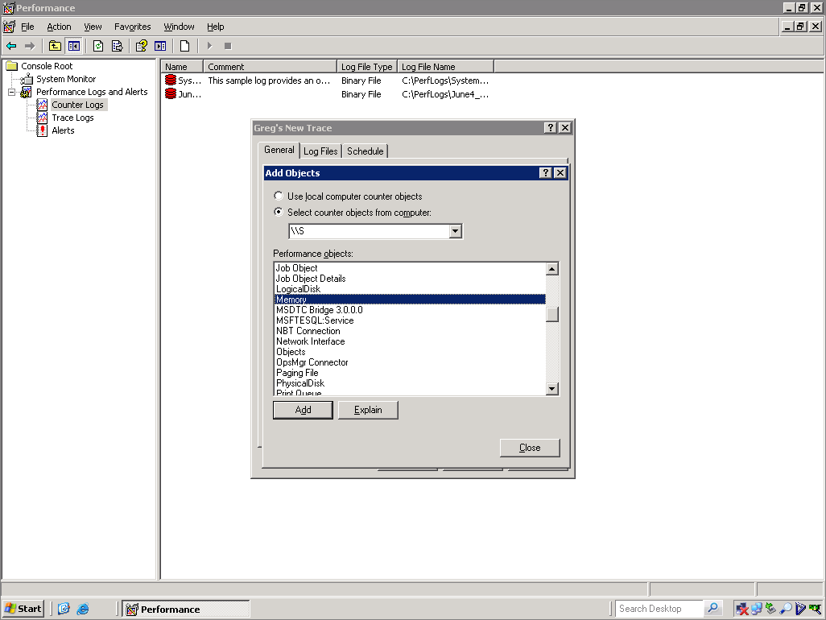

Slide 113
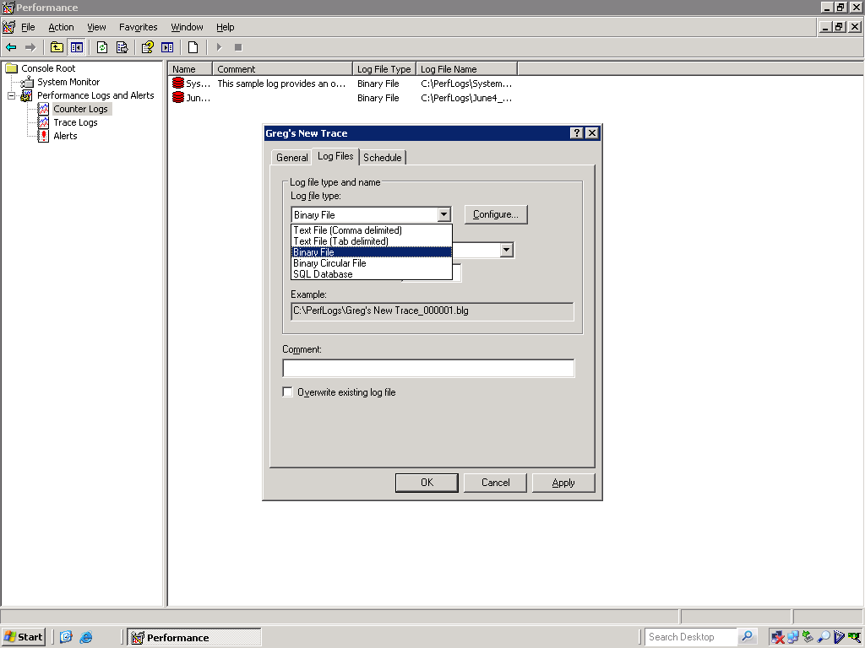

Slide 114
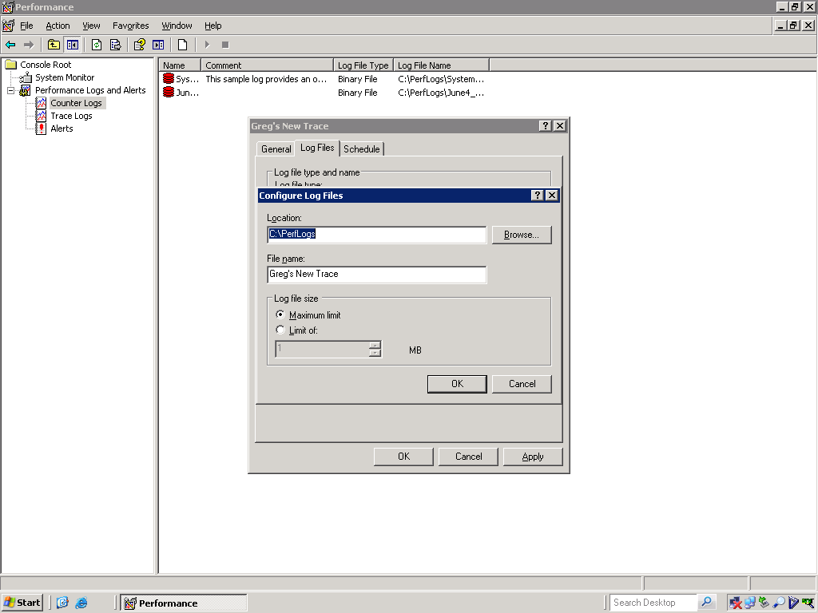

Slide 115
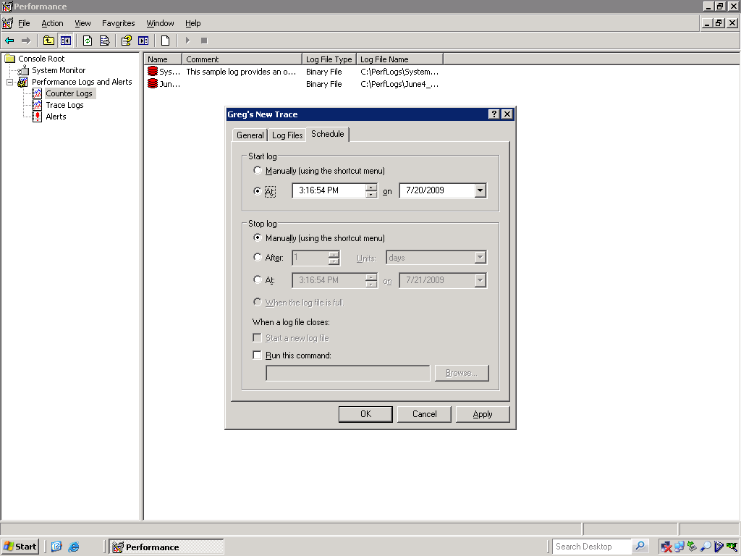

Slide 116
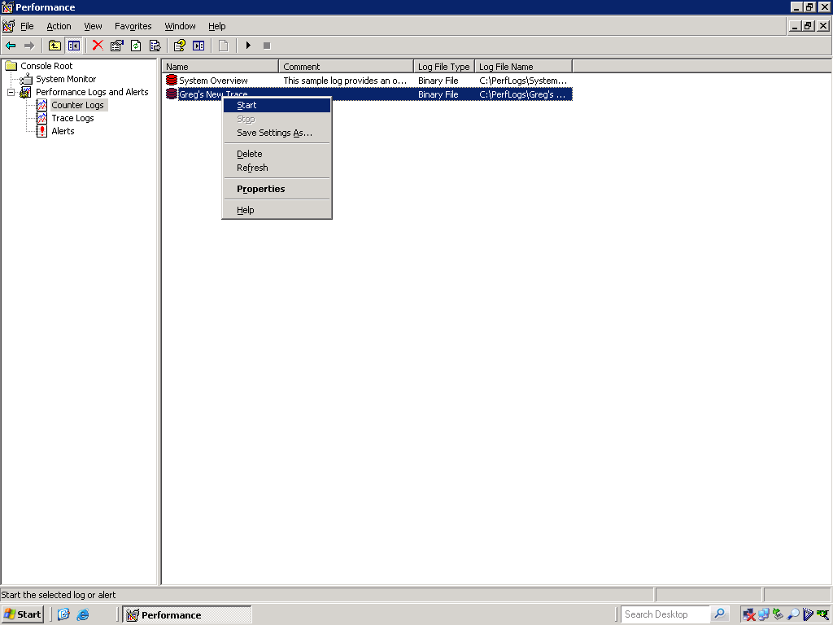

Slide 117
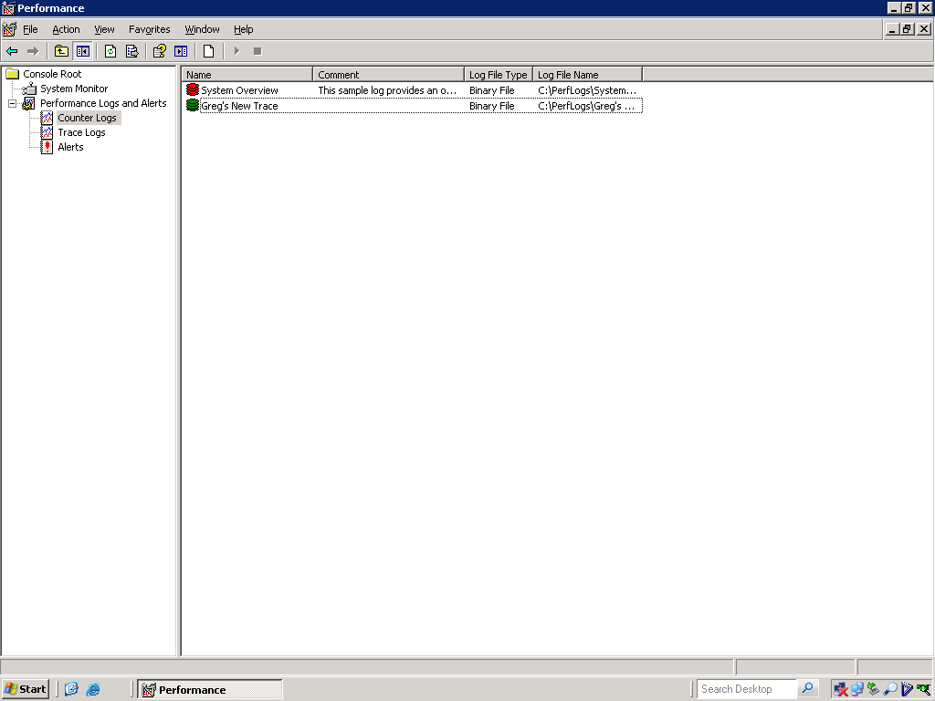

Slide 118
Questions?

Slide 119
System Monitor
Alerts
Able to be proactive
Early notification of thresholds passed

Slide 120
Demo: System Monitor Alerts

Slide 121
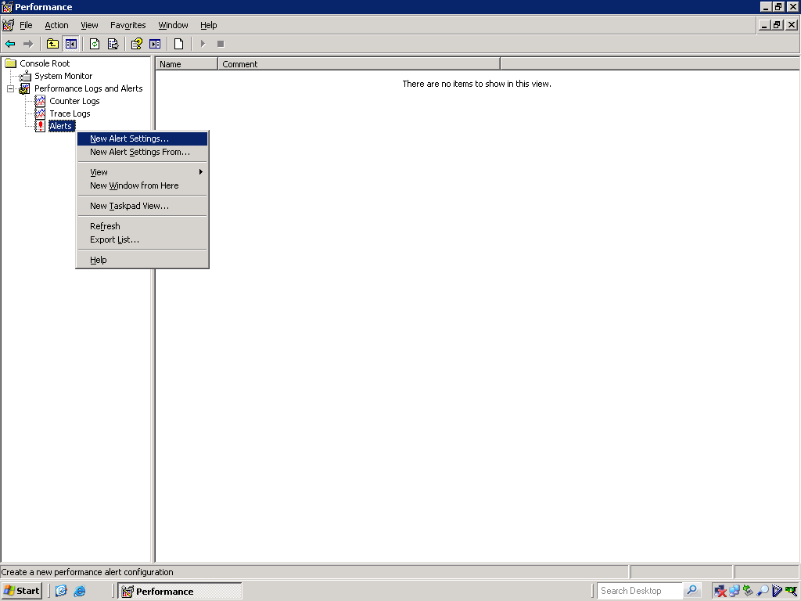

Slide 122
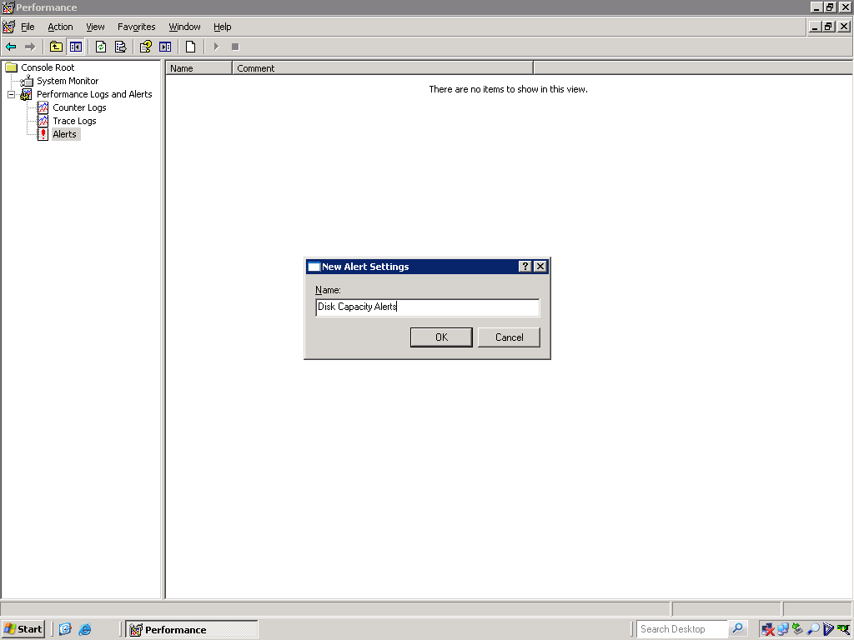

Slide 123
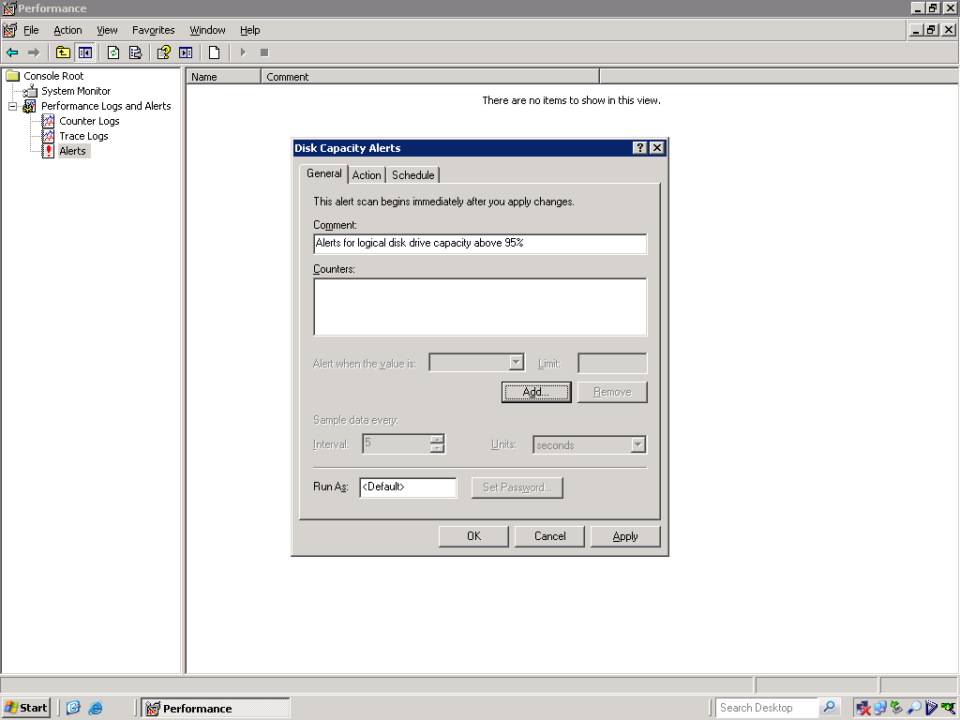

Slide 124


Slide 125


Slide 126


Slide 127


Slide 128
Questions?

Slide 129
Reliability Monitor
Reporting capability
Quick reporting on uptime
Lets administrators measure failures

Slide 130
Demo: Reliability Monitor

Slide 131


Slide 132


Slide 133
Questions?

Slide 134
Task Manager
Quick look at system resources
Often the best point to begin troubleshooting

Slide 135
Demo: Task Manager

Slide 136


Slide 137


Slide 138


Slide 139


Slide 140


Slide 141


Slide 142


Slide 143
Questions?

Slide 144

Dynamic Management Views

Slide 145
Dynamic Mgt Views & Functions
Key Performance\Monitoring DMVs & DMFs
DMV and DMF Prefixes
dm_db_*
dm_exec_*
dm_io_*
dm_os_*

Slide 146
Dynamic Mgt Views & Functions
dm_db_*
Range of database statistics
Space and index utilization

Slide 147
Dynamic Mgt Views & Functions
dm_exec_*
Range of Query statistics
Replaces ‘old school’ code sp_who2 and sp_lock

Slide 148
Dynamic Mgt Views & Functions
dm_io_*
Range of I/O statistics
Current data previously required System Monitor

Slide 149
Dynamic Mgt Views & Functions
dm_os_*
Range of hardware-level information
Fantastic measurements most-effective

Slide 150
Dynamic Mgt Views & Functions
Database Statistics
sys.dm_db_index_usage_stats (DMV)
Contains core statistics about each index in db
sys.dm_db_index_operational_stats (DMF)
Takes 4 parameters
Database_id
Object_id
Index_id
Partition_id
Displays all current info on locking\latching

Slide 151
Dynamic Mgt Views & Functions
Database Statistics
sys.dm_db_index_physical_stats (DMF)
Takes 5 parameters
Database_id
Object_id
Index_id
Partition_id
Mode
Replaces DBCC SHOWCONTIG

Slide 152
Dynamic Mgt Views & Functions
Database Statistics
sys.dm_db_missing_index_*
sys.dm_db_missing_index_details
sys.dm_db_missing_index_group_stats
sys.dm_db_missing_index_groups
Able to assess where indexes could be best
Not as robust as DTA but VERY quick

Slide 153
Dynamic Mgt Views & Functions
Query Statistics
sys.dm_exec_sessions
Covers functionality for connections to instance
Replaces sp_who2
sys.dm_exec_requests
Covers functionality for queries inside engine
Basis for resolving many performance issues
Query settings
Query execution
Transaction
Resource allocation

Slide 154
Dynamic Mgt Views & Functions
I/O Statistics
sys.dm_io_virtual_file_stats
Similar to fn_virtual_filestats() function in SQL 2000
More granular
I/O stats are cumulative since SQL was started
sys.dm_io_pending_io_requests
One row for each request waiting for I/O

Slide 155
Dynamic Mgt Views & Functions
Hardware Statistics
sys.dm_os_performance_counters
Allows similar but easier data to System Monitor
sys.dm_os_wait_stats
Replaces DBCC SQLPERF(WAITSTATS)
Review wait types

Slide 156

Questions?

Slide 157
Working with SQL Server Profiler
Defining a Trace
Have a plan!!
Data scope
Filters
Events and Data Columns
Start with a predefined template
Different scenarios have distinct template
Build a set of templates to capture info quickly

Slide 158
Dynamic Mgt Views & Functions
Database Statistics
sys.dm_db_index_usage_stats (DMV)
Contains core statistics about each index in db
sys.dm_db_index_operational_stats (DMF)
Takes 4 parameters
Database_id
Object_id
Index_id
Partition_id
Displays all current info on locking\latching

Slide 159
Dynamic Mgt Views & Functions
Database Statistics
sys.dm_db_index_physical_stats (DMF)
Takes 5 parameters
Database_id
Object_id
Index_id
Partition_id
Mode
Replaces DBCC SHOWCONTIG

Slide 160
Dynamic Mgt Views & Functions
Database Statistics
sys.dm_db_missing_index_*
sys.dm_db_missing_index_details
sys.dm_db_missing_index_group_stats
sys.dm_db_missing_index_groups
Able to assess where indexes could be best
Not as robust as DTA but VERY quick

Slide 161
Dynamic Mgt Views & Functions
Query Statistics
sys.dm_exec_sessions
Covers functionality for connections to instance
Replaces sp_who2

Slide 162
Dynamic Mgt Views & Functions
Query Statistics
sys.dm_exec_requests
Covers functionality for queries inside engine
Basis for resolving many performance issues
Query settings
Query execution
Transaction
Resource allocation

Slide 163
Dynamic Mgt Views & Functions
I/O Statistics
sys.dm_io_virtual_file_stats
Similar to fn_virtual_filestats() function
More granular
I/O stats are cumulative since SQL was started
sys.dm_io_pending_io_requests
One row for each request waiting for I/O

Slide 164
Dynamic Mgt Views & Functions
Hardware Statistics
sys.dm_os_performance_counters
Allows similar but easier data to System Monitor
sys.dm_os_wait_stats
Replaces DBCC SQLPERF(WAITSTATS)
Review wait types

Slide 165
Creating Performance Baseline
Defines what is currently ‘normal’
PerfMon
Create a log
Capture measurements 2-3 times a minute
Standard Counters
Become familiar with what is important for YOU

Slide 166
Measuring Memory
Memory
Available MB: Average > 10MB
Pages/sec: Average < 50
SQL Server: Buffer Mgr
Buffer Cache Hit Ratio: Average > 90%
Free Pages: Min Value > 640
SQLServer: Memory Manager
Memory Grants Pending: Average = 0
Target Server Memory: Close to physical memory
Total Server Memory: Close to Target Server memory

Slide 167
Measuring Disk I/O
PhysicalDisk
% Disk Time: < 5%
Current Disk Queue Length: < 2 per disk
Avg Disk Queue Length: < 2 per disk
Disk Transfers/sec: Max Value < 100
Disk Bytes/sec: Max Value <10 MB/sec

Slide 168
Measuring CPU
Processor (_Total)
% Processor Time: Average < 80%
% Privileged Time: Average < 10%
System
Proc Queue Length: Average < 2
Context Switches/sec: Avg < 1000 per processor
SQLServer: SQL Statistics
Compilations/sec: ~ 0
Re-Compilations/sec: ~ 0

Slide 169
Miscellaneous
SQLServer: Access Methods
Free Space Scans/sec: ~ 0
Full Scans/sec: ~ 0
Page Splits/sec < 12,000/sec
SQL Server: General Statistics
User Connections: varies by load
SQLServer: Latches
Total Latch Wait time: ~ 0
SQLServer: Locks
Lock Timeouts/sec: 0 (!)
Lock Wait time: ~ 0
Number of Deadlocks/sec: 0 (!)

Slide 170

Key Points: Creating a Baseline
Invaluable when troubleshooting
Able to identify trends and avert problems
Makes technicians pay attention

Slide 171

Questions?

Slide 172


Slide 173


